Slide 1

Tutorial 6
More Details About API’s

Slide 2
HTTP Protocol
HTTP protocol acts as the set of rules that computers follow when they are interacting with one another.
Example: Suppose we are in a checkout line in a grocery store. The set of rules we have to follow when checking out are that we wait until there is nobody in front of us before we can checkout
When computers communicate with one another they must make sure that they are following the correct set of instructions(http protocol) when doing so.

Slide 3
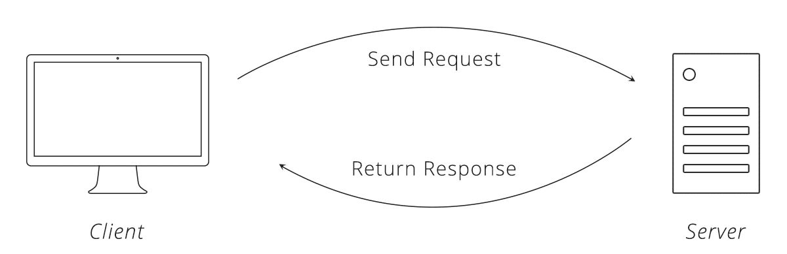
HTTP Requests
One of the most significant concepts in communication between computers using HTTP protocol is the Request-Response cycle
When a client makes an HTTP request to a server, the server sends bake an HTTP response.

Slide 4
HTTP Request
Made up of 4 parts: url, method, list of headers, body
URL is the unique address for an item on the web
Methods: Get, put, post, delete
Headers is a summarization of what we are trying to do
Body contains the list of information that we want to send the server

Slide 5
HTTP Request Methods
Get: asks the server to get the resource
Post: asks server to create a new resource
Example

Slide 6
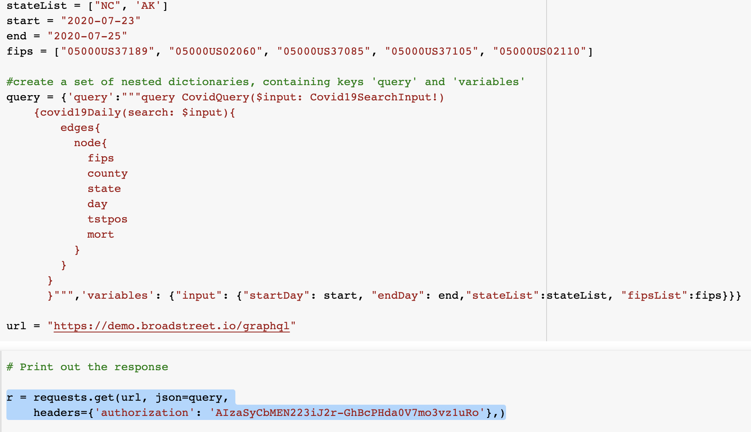
What does it look like?

Slide 7

API(Application Programming Interface)
An API is a way that two applications can talk to each other and transfer information
API is a tool that make a website’s data accessible for a computer

Slide 8
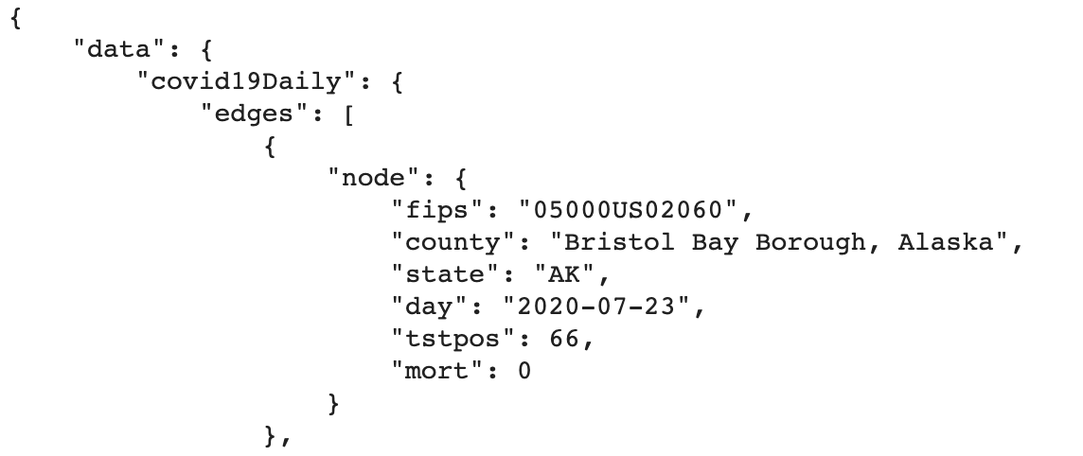
HTTP Response(Using an API)
When a HTTP response is sent to the client, the data that comes in the response is formatted in a nice accessible format such as JSON
Example:

Slide 9
Summary
Using an API, we send a request to a server. Depending on what method, headers, and body we use, the server sends us a response(for us it was in JSON format) that we are then able to use on our own.

